Slide 1
Data Structures
ICT-1211
Information and Communication Technology
Lecture-21
Date: //2024

Slide 2
Stacks, Queues, Recursion

Slide 3
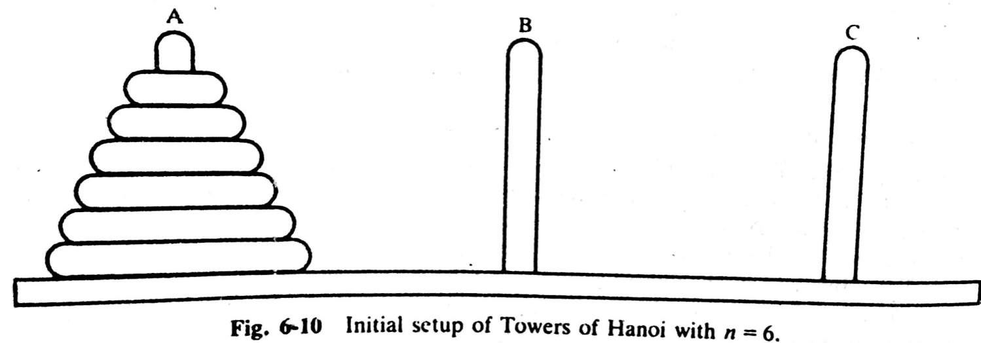
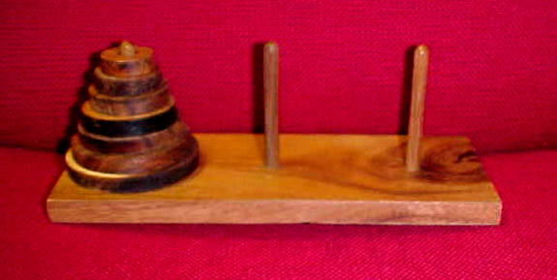
TOWER of HANOI Problem
Notes:
The preceding section gave examples of some recursive definition and procedures. Recursion may be used as a tool in developing an algorithm to solve a particular problem. The problem we pick is known as Tower of Hanoi problem.

Slide 4
TOWER of HANOI Problem
  Only one disc could be moved at a time
  A larger disc must never be stacked above a smaller one
  One and only one extra needle could be used for intermediate storage of discs
Notes:
The preceding section gave examples of some recursive definition and procedures. Recursion may be used as a tool in developing an algorithm to solve a particular problem. The problem we pick is known as Tower of Hanoi problem.

Slide 5
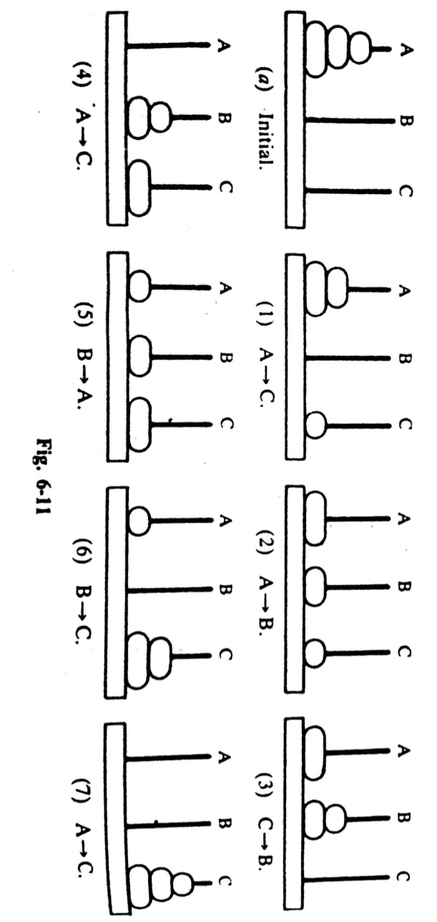
TOWER of HANOI Problem Solution
The solution to the Tower of Hanoi problem for n=3 appears
N=3: A→C, A→B, C→B, A→C, B→A, B→C, A→C,
Notes:
The preceding section gave examples of some recursive definition and procedures. Recursion may be used as a tool in developing an algorithm to solve a particular problem. The problem we pick is known as Tower of Hanoi problem.

Slide 6
TOWER of HANOI Problem Solution
The SEPARATE SOLUTION to the Tower of Hanoi problem
for n=1
Solution: A→C
n=2
Solution: A→B, A→C, B→C
n=3
Solution: A→C, A→B, C→B, A→C, B→A, B→C, A→C
General Solution to the Tower of Hanoi for any # of Disk is PREFERRED.
Which can be done in RECURSIVE way.
Notes:
The preceding section gave examples of some recursive definition and procedures. Recursion may be used as a tool in developing an algorithm to solve a particular problem. The problem we pick is known as Tower of Hanoi problem.

Slide 7
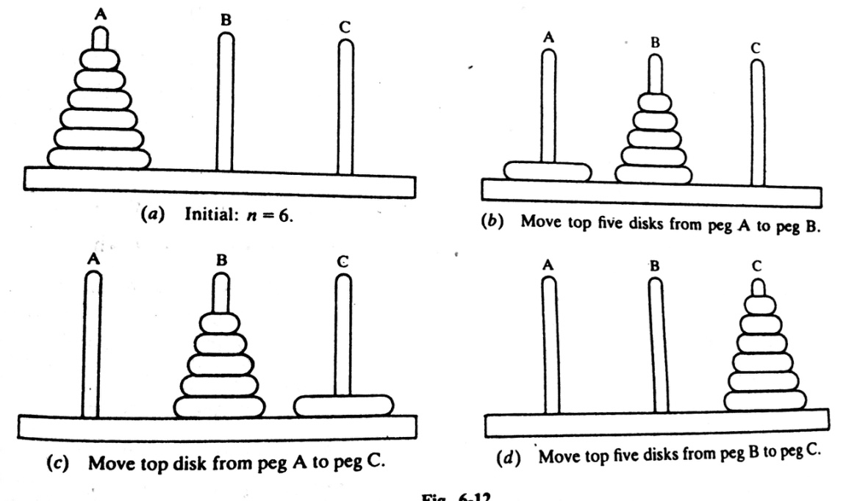
Solution of TOWER of HANOI in RECURSIVE WAY
The solution to the Tower of Hanoi problem for n>1 disks may be reduced to the following sub-problems:
  Move the top n-1 disks from peg A to peg B.
  Move the top disk from A to peg C: A→C
  Move the top n-1 disks from peg B to peg C
Notes:
The preceding section gave examples of some recursive definition and procedures. Recursion may be used as a tool in developing an algorithm to solve a particular problem. The problem we pick is known as Tower of Hanoi problem.

Slide 8
Solution of TOWER of HANOI in RECURSIVE WAY
The general notation of the solution for any # of disk:
TOWER(N, BEG, AUX, END)
When n=1 then
TOWER(1, BEG, AUX, END)
BEG → END, But
When n> 1 then then solution may be reduced to the solution of the following three sub-problem:
          TOWER (N-1, BEG, END, AUX)
          TOWER (1, BEG, AUX, END)
          TOWER (N-1, AUX, BEG, END)
Notes:
Its to denote a procedure which moves the top n disk from the initial peg BEG to the final peg END using the peg AUX as an auxiliary. When n=1, we

Slide 9
Formal TOWER of HANOI Problem Solving Procedure
TOWER (N, BEG, AUX, END)
Step1. If N=1, then:
(a) Write: BEG→END.
(b) Return.
[End of If Structure]
Step2. [Move N-1 disks from peg BEG to peg AUX.]
Call TOWER (N-1, BEG, END, AUX).
Step3. Write: BEG → END.
Step4. [Move N-1 disks from peg AUX to peg END.]
Call TOWER (N-1), AUX, BEG, END).
Step5. Return
Notes:
The preceding section gave examples of some recursive definition and procedures. Recursion may be used as a tool in developing an algorithm to solve a particular problem. The problem we pick is known as Tower of Hanoi problem.

Slide 10
Recursive Solution to TOWER of HANOI Problem
T(1,A,C,B)
A→B
--------------------------------------------- A→B
T(2,A,B,C)
T(1,A,B,C)
A→C
--------------------------------------------- A→C
T(1,B,A,C)
B→C
--------------------------------------------- B→C
Moving Sequences
T(3,A,C,B)
T(1,A,C,B)
A→B
--------------------------------------------- A→B
T(1,C,B,A)
C→A
--------------------------------------------- C→A
T(2,C,A,B)
T(1,C,A,B,)
C→B
--------------------------------------------- C→B
T(1,A,C,B)
A→B
--------------------------------------------- A→B
T(4,A,B,C)
T(1,A,B,C)
A→C
--------------------------------------------- A→C
T(1,B,A,C)
B→C
------------------------------------------- B→C
T(2,B,C,A)
T(1,B,C,A)
B→A
---------------------------------------- B→A
T(1,C,B,A)
C→A
--------------------------------------------- C→A
T(3,B,A,C)
T(1,B,A,C)
B→C
--------------------------------------------- B→C
T(1,A,C,B)
A→B
--------------------------------------------- A→B
T(2,A,B,C)
T(1,A,B,C)
A→C
--------------------------------------------- A→C
T(1,B,A,C)
B→C
--------------------------------------------- B→C
Notes:
The preceding section gave examples of some recursive definition and procedures. Recursion may be used as a tool in developing an algorithm to solve a particular problem. The problem we pick is known as Tower of Hanoi problem.

Slide 11
Implementation of Recursive Pro. By STACKS
Before implementing Recursive procedures…..
Imagine a SUBPROGRAM…
  It may contain both parameters, and local variables.
  The parameters are the variables which receive values from objects in the CALLING PROGRAM.
  It transmit values back to the CALLING PROGRAM.
  It must also keep track of the return address in the CALLING PROGRAM.
  The return address is essential, since control must be transferred back to its proper place in the CALLING PROGRAM.
  Once the subprogram finished executing and control is transferred back to the CALLING PROGRAM.
  The values of the local variables and the return address are no longer needed.

Slide 12
Implementation of Recursive Pro. By STACKS
Suppose SUBPROGRAM is a recursive program…then
Each level of execution of the subprogram may contain different values for the parameters and local variables, and for the return address.
Furthermore, if the recursive program does call itself, then these current values must be saved, since they will be used again when the program is reactivated.

Slide 13
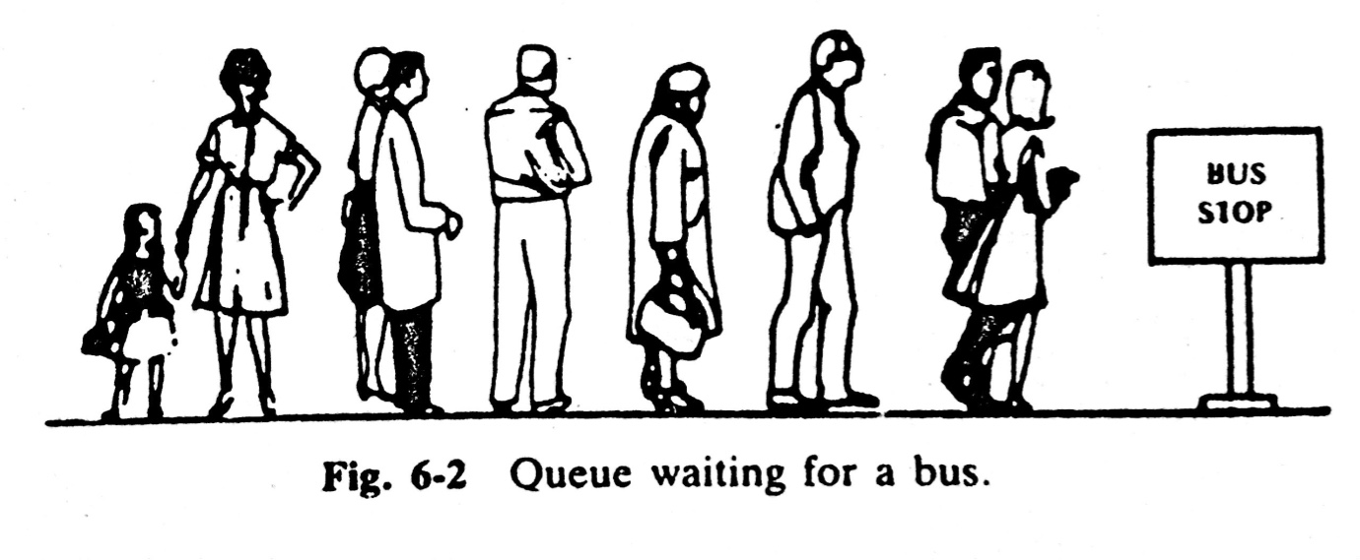
Queues
A queue is a linear list of elements in which…
  deletions can take place only at one end, called the front, and
  insertions can take place only at the other end, called the rear.
Queues are also called first-in first-out (FIFO) list
This contrasts with stacks, which are LIFO
An important example of a queue in computer science occurs in a timesharing system in which programs with the same priority form a queue while waiting to be executed.

Slide 14
Queues: Example
Consider a Queue with 4 elements
AAAA | BBBB | CCCC | DDDD | EEE
front
rear
Suppose an element is deleted from the 4 element queue.
Which is we can delete??
AAAA
Then which one is considered to be the front element?
BBBB
Suppose EEEE is added to the queue
Then which one is considered to be the rear element?
EEEE

Slide 15
Queues: Representation
Queues may be represented in the computer in various ways.
Usually by means of
          One-way list
          Linear arrays
Each of the queues will be maintained by …
      A Linear Array QUEUE
      Two pointer variables:
        FRONT (containing the location of the front element of the Queue)
        REAR (containing the location of the rear element of the Queue)
The condition FRONT= NULL will indicate that the Queue is……
                EMPTY.

Slide 16
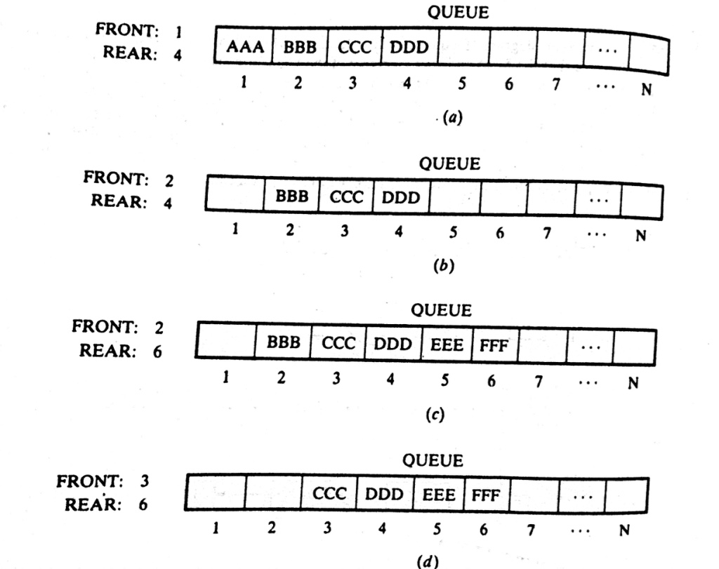
Queues: Representation

Slide 17
Thank you……

